Slide 1
UNIT 4
Heat Treatment

Slide 2
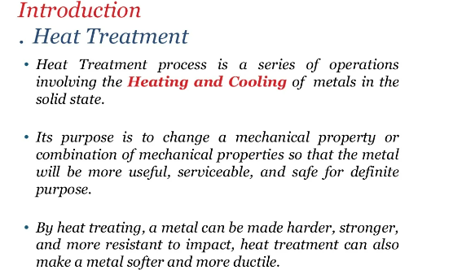

Slide 3
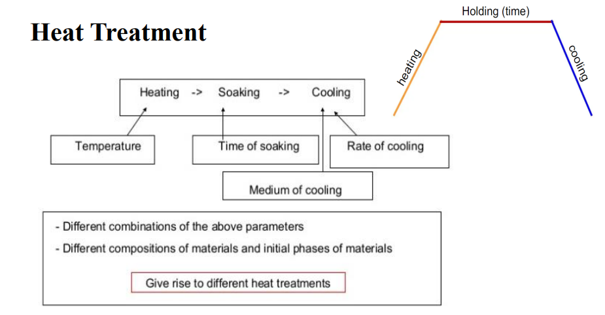

Slide 4
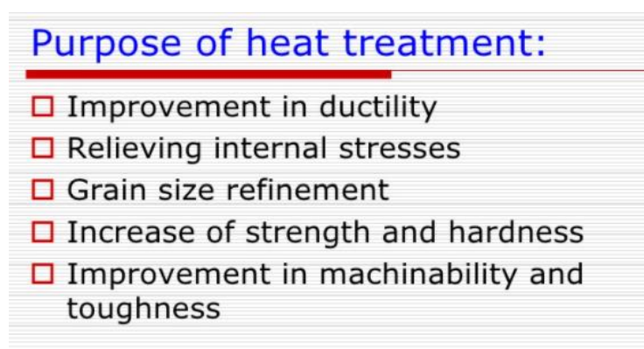

Slide 5
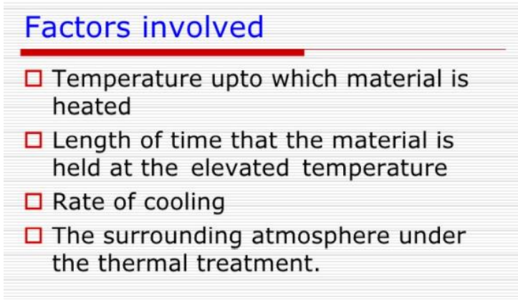

Slide 6
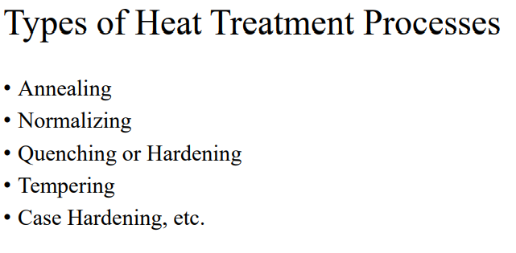

Slide 7
Annealing
It is the process for softening materials or to bring about required changes in properties, such as machinability, mechanical or electrical properties, or dimensional stability.
The annealing process consists of heating the steel to or near the critical temperature (temperature at which crystalline phase change occurs) to make it suitable for fabrication.
A material can be annealed by heating it to a specific temperature and then letting the material slowly cool to room temperature in an oven.

Slide 8
Why Annealing?
It softens steel and to improve its machinability.
To refine grain size and remove gases.
It removes the internal stresses developed during the previous process.
To obtain desired ductility, malleability, and toughness.
It modifies the electrical and magnetic properties.

Slide 9
Types of Annealing
Process Annealing
Full Annealing
Stress relief annealing
Spheroidizing
Normalizing, etc.,

Slide 10
Process Annealing
This process is mainly suited for low carbon steel.
Metal is heated to temperature some below or close to the lower critical temperature generally it is heated 550°C to 650°C holding at this temperature and it is slowly cooled.
Cold worked steel normally have increased hardness and decrease ductility making it difficult to work.
Process annealing improves this characteristics by making it more ductile and decreasing its hardness. This is mainly carried out on cold rolled steel like wire drawn steel, etc.

Slide 11
Full Annealing
The main purpose of full annealing of steel is to soften it and to refine its grain structure.
In this, the hypo-eutectoid steel is heated to a temperature approximately 20° to 30°C above the higher critical temperature and for hypereutectoid steel and tool steel is heated to a temperature 20 to 30°C above the lower critical temperature and this temperature is maintained for a definite time and then slowly cooled very slowly in the furnace itself.

Slide 12
Stress Relief Annealing
In stress relief annealing, the metal is heated to a lower temperature about 650º degree and is kept at this temperature for some time in the furnace to remove the internal stress of metal followed by slow cooling.
Large castings or welded structures tend to possess internal stresses mainly caused during their manufacturing and uneven cooling.

Slide 13
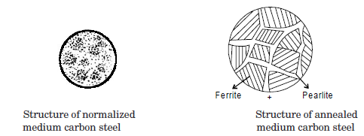
Spheroidizing Annealing
Spheroidizing Annealing process is for high carbon and alloy steel in order to improve their manufacturability.
It is lowest temperature range of annealing process in which iron base alloys are heated 20 to 40°C below the lower critical temperature, held therefore a considerable period of time e.g. for 2.5 cm diameter piece the time recommended is four-hours. It is then allowed to cool very slowly at room temperature in the furnace itself.
The holding time varies from 15-25 hours. it it is mainly used for eutectoid steel and hypereutectic steel such as carbon tool steel, alloy tool steel, bearing steel etc.

Slide 14
Normalization Annealing
Normalization is a type of annealing process which is carried to enhance the hardness of steel.
In this process, the steel is heated above its upper critical temperature.
Due to the heating process involved in the normalization, there is the formation of the austenite structure.

Slide 15
Normalizing
It is a type of heat treatment applicable to ferrous metals only.
It differs from annealing in that the metal is heated to a higher temperature and then removed from the furnace for air cooling.
The purpose of normalizing is to remove the internal stresses induced by heat treating, welding, casting, forging, forming, or machining.

Slide 16
Comparison between Annealing and Normalising
S. No. | Annealing | Normalizing
1 | In this hypo-eutectoid steel is heated to a temperature approximately 20 to 30°C above temperature the higher critical temperature and for hypereutectoid steel is heated 20 to 30°C above the lower critical temperature. | In this metal is heated 30 to 50°C above higher critical temperature.
2 | It gives good results for low and medium carbon steel | It also gives very good results for low and medium carbon steel
3 | It gives high ductility | It induces gives higher ultimate strength, yield point and impact strength in ferrous material.
4 | It is basically required to soften the metal, to improve machinability, to increase ductility, improve, to refine grain size. | It is basically required to refine grain size, improve structure of weld, to relieve internal stresses.

Slide 17
Quenching or Hardening
It is done to increase the strength and wear properties. One of the prerequisites for hardening is sufficient carbon and alloy content.
To harden by quenching, a metal (usually steel or cast iron) must be heated into the austenitic crystal phase and then quickly cooled.
Depending on the alloy and other considerations (such as concern for maximum hardness vs. cracking and distortion), cooling may be done with forces air or other gas (such as nitrogen), oil, polymer dissolved in water, or brine.

Slide 18
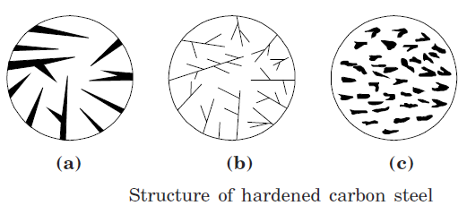
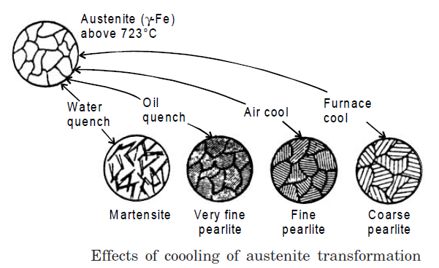

Slide 19
Case Hardening
Some times special characteristic are required in metal such as hard outer surface and soft, tough and more strength oriented core or inner structure of metal.
This can be obtained by casehardening process.
It is the process of carburization i.e. saturating the surface layer of steel with carbon or some other substance by which outer case of the object is hardened where as the core remains soft. It is applied to very low carbon steel.
It is performed for obtaining hard and wear resistance on surface of metal and higher mechanical properties with higher fatigue, strength and toughness in the core.

Slide 20
Case hardening process
(1) Carburizing
(2) Nitriding.
(3) Cyaniding.
(4) Induction hardening.
(5) Flame hardening

Slide 21
Carburizing
Carburizing can be of three types
1. Pack carburizing
2. Liquid carburizing and
3. Gas carburizing

Slide 22
Pack Carburizing
Metals to be carburized such as low carbon steel is placed in cast iron or steel boxes containing a rich material in carbon like charcoal, crushed bones, potassium Ferro-cyanide or charred leather.
Such boxes are made of heat resisting steel which are then closed and sealed with clay.
Long parts to be carburized are kept vertical in -boxes.
The boxes are heated to a temperature 900°C to 950°C according to type of steel for absorbing carbon on the outer surface.
The carbon enters the on the metal to form a solid solution with iron and converts the outer surface into high carbon steel.
Consequently pack hardened steel pieces have carbon content up to 0.85% in their outer case.

Slide 23
Small gears are case hardened by this process for which they are enclosed in the cast iron or steel box containing a material rich in carbon, such as small piece of charcoal and then heat to a temperature
slightly above the critical range.
Depth of hardness from 0.8-1.6 mm is attained in three to four hours.

Slide 24
Liquid Carburizing
Liquid carburizing (Salt bath carburizing) is carried out in a container filled with a molten salt, such as sodium cyanide.
This bath is heated by electrical immersion elements or by a gas burner and stirring is done to ensure uniform temperature.
Parts which are to be case-hardened are dipped into liquid bath solution containing calcium cyanide and polymerized hydro-cyanide acid or sodium or potassium cyanide along-with some salt.
In this heating, time is short and the clean hardened layer is upto 3 mm thickness.

Slide 25
Advantages of the liquid bath carburizing
Greater depth of penetration possible in this process.
Selective carburizing is possible if needed.
Uniform heating will occur in this process.
Ease of carburizing for a wider range of products.
It is time saving process.
Parts leave the bath with a clean and bright finish.

Slide 26
Gas Carburising
In gas carburizing method, the parts to be gas carburized are surrounded by a hydrocarbon gas in the furnace.
The common carburizing gases are methane, ethane, propane, butane and carbon monoxide are used in this process.
In this method, the overall time taken is very much shorter.
More uniform results with regard to case depth re obtained.

Slide 27
Cyaniding
Cyanide may also be used to case harden the steel. It is used to give a very thin but hard outer case.
Cyaniding is a case hardening process in which both C and N₂ in form of cyaniding salt are added to surface of low and medium carbon steel.
Sodium cyanide or potassium cyanide may be used as the hardening medium.
It is a process of superficial case hardening which combines the absorption of carbon and nitrogen to obtain surface hardness.
The components to be case hardened are immersed in a bath having fused sodium cyanide salts kept at 800-850°C.
The component is then quenched in bath or water.

Slide 28
This method is very much effective for increasing the fatigue limit of medium and small sized parts such as gears, spindle, shaft etc.
Cyaniding process gives bright finishing on the product. In it, distortion can be easily avoided and fatigue limit can be increased.
But the main disadvantage of this process is that it is costly and highly toxic process in comparison to other process of case hardening.

Slide 29
Applications of Cyaniding
Cyaniding is generally applied to
The low carbon steel parts of automobiles (sleeves, brake cam, speed box gears, drive worm screws, oil pump gears etc),
Motorcycle parts (gears, shaft, pins etc.) and
Agriculture machinery.

Slide 30
Nitriding
Nitriding is a special case hardening process of saturating the surface of steel with nitrogen by holding it for prolonged period generally in electric furnace at temperature from 480°C to 650°C in atmosphere of Ammonia gas (NH₃).
The nitrogen from the ammonia gas enters into on the surface of the steel and forms nitrides and that impart extreme hardness to surface of the metal.
Nitriding is a case hardening process in which nitrogen instead of carbon is added to the outer skin of the steel.

Slide 31
This process is used for those alloys which are susceptible to the formation a chemical nitrides.
The article to be nitride is placed in a container (made of high nickel chromium steel).
Container is having inlet and outlet tubes through which ammonia gas is circulated.
Ammonia gas is used as the nitrogen producing material. The alloy steel containing Cr, Ni, Al, Mo, V and Nitre-alloy are widely used for this process.

Slide 32
Applications of Nitriding
Many automobile, diesel engines parts, pumps, shafts, gears, clutches, etc. are treated with the nitriding process.
This process is used for the parts which require high wear resistance at elevated temperatures such as automobile and air plane valve’s and valve parts, piston pins, crankshafts, cylinder liners etc.
It is also used in ball and roller bearing parts die casting
dies, wire drawing dies etc.

Slide 33
Flame Hardening
It consists of moving an oxyacetylene flame, over the part where hardening is required.
Immediately after this, the heated portion is quenched by means of water spray or air passing over it.
Temperature attained by the surface is controlled and the rate of cooling is controlled by selecting a suitable medium.
Flame hardening is suitable for large sized articles where
only some portions of the surface requiring hardening and hence there is no need to heat the whole article in the furnace.

Slide 34
Induction Hardening
Induction hardening is accomplished by placing the part in a high frequency alternating magnetic field.
It differs from surface hardening in the way that hardness of surface is not due to the increase in carbon content but due to rapid heating followed by controlled quenching.
In this process, a high frequency current is introduced in the metal surface and its temperature is raised up to hardening range.
As this temperature is attained, the current supply is cut off
instantaneously water is sprayed on the surface.

Slide 35
Advantages of Induction hardening
Applications of Induction hardening
Induction hardening is comparatively quicker.
A minimum distortion or oxidation is encountered because of the short cycle time.
The operation is very fast and comparatively
large parts can be processed in a minimum time.
Induction hardening is widely used for hardening surfaces of crankshafts, cam shafts, gear automobile components, spline shafts, spindles, brake drums etc.
It is also used for producing hard surfaces on cam, axles, shafts and gears.

Slide 36
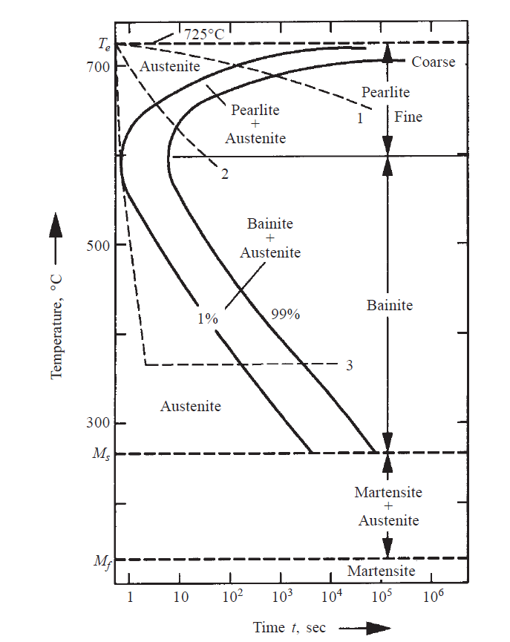

Slide 37
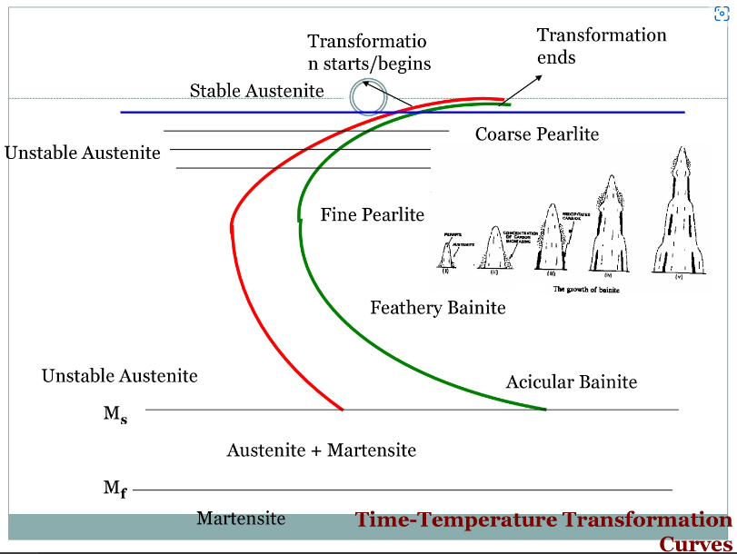

Slide 38
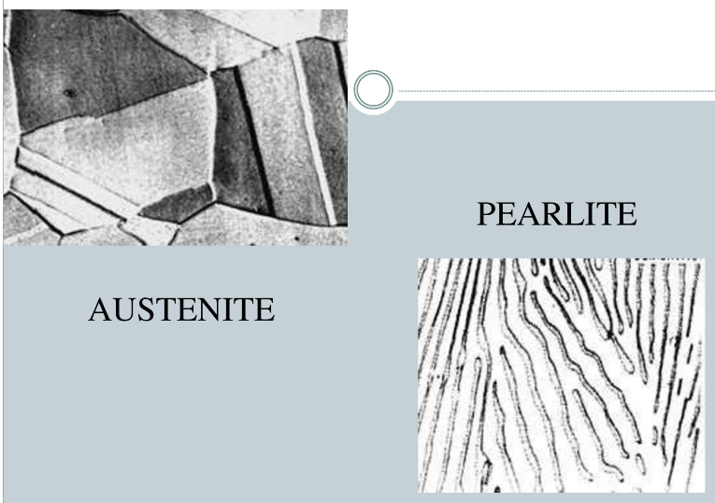

Slide 39
Tempering
If high carbon steel is quenched for hardening in a bath, it becomes extra hard, extra brittle and has unequal distribution internal stresses and strain and hence unequal hardness and toughness in structure.
These extra hardness, brittleness and unwanted induced stress and strain in hardened metal reduce the usability the metal.
Therefore, these undesired needs must be reduced for by reheating and cooling at constant bath temperature.

Slide 40
In tempering, steel after hardening, is reheated to a temperature below the lower critical temperature and then followed by a desired rate of cooling.
Reheating the of hardened steel is done above critical temperature when the structure is purely of austenite and then quenching it in a molten salt path having temperature in the range of 150-500°C.
This is done to avoid transformation to ferrite and pearlite and is held quenching temperature for a time sufficient to give complete formation to an intermediate structure referred to as bainite then cooled to room temperature.

